Slide 1
Advanced Databases Lecture 3: DB Normalization
Dr. Pierpaolo Dondio,
DT228/4

Slide 2
Database Tables and Normalization
Normalization is a process for assigning attributes to entities. It reduces data redundancies and helps eliminate the data anomalies.
Normalization works through a series of stages called normal forms:
First normal form (1NF)
Second normal form (2NF)
Third normal form (3NF)
Boyce-Codd NF (BCNF)
The highest level of normalization is not always desirable.

Slide 3
Database Tables and Normalization
The Need for Normalization
Case of a Construction Company
Building project -- Project number, Name, Employees assigned to the project.
Employee -- Employee number, Name, Job classification
The company charges its clients by billing the hours spent on each project. The hourly billing rate is dependent on the employee’s position.
Periodically, a report is generated.
The table whose contents correspond to the reporting requirements is shown in Table 5.1.

Slide 4
Scenario
A few employees works for one project.
Project Num : 15
Project Name : Evergreen
Employee Num : 101, 102, 103, 105

Slide 5
Sample Form
Project Num : 15
Project Name : Evergreen
Emp Num | Emp Name | Job Class | Chr Hours | Hrs Billed | Total
101
102
103
105

Slide 6
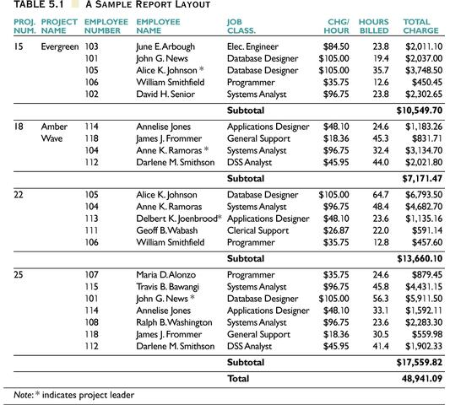
Sample Data

Slide 7
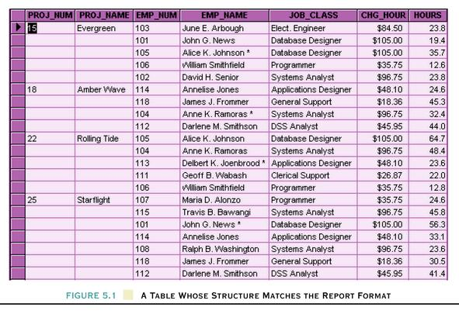
Table Structure Matches the Report Format

Slide 8
Database Tables and Normalization
Problems with the Figure 5.1
The project number is intended to be a primary key, but it contains nulls.
The table displays data redundancies.
The table entries invite data inconsistencies.
The data redundancies yield the following anomalies:
Update anomalies.
Addition anomalies.
Deletion anomalies.

Slide 9
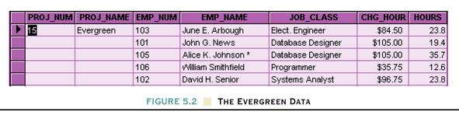
Database Tables and Normalization
Conversion to First Normal Form
A relational table must not contain repeating groups.
Repeating groups can be eliminated by adding the appropriate entry in at least the primary key column(s).

Slide 10
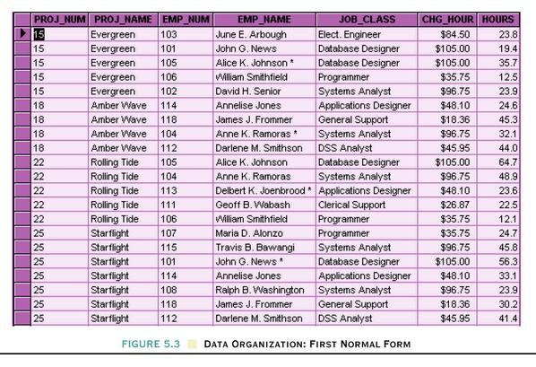
Data Organization:
First Normal Form
After
...then split the relation into table
Before

Slide 11
First Normal Form (1 NF)
1NF Definition
The term first normal form (1NF) describes the tabular format in which:
All the key attributes are defined.
There are no repeating groups in the table.
All attributes are dependent on the primary key.

Slide 12
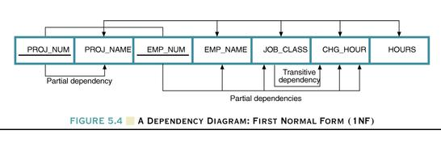
Dependency Diagram
Dependency Diagram
The primary key components are bold, underlined, and shaded in a different color.
The arrows above entities indicate all desirable dependencies, i.e., dependencies that are based on PK.
The arrows below the dependency diagram indicate less desirable dependencies -- partial dependencies and transitive dependencies.

Slide 13
Second Normal Form (2 NF)
Conversion to Second Normal Form
Starting with the 1NF format, the database can be converted into the 2NF format by
Writing each key component on a separate line, and then writing the original key on the last line and
Writing the dependent attributes after each new key.
PROJECT (PROJ_NUM, PROJ_NAME)
EMPLOYEE (EMP_NUM, EMP_NAME, JOB_CLASS, CHG_HOUR)
ASSIGN (PROJ_NUM, EMP_NUM, HOURS)

Slide 14
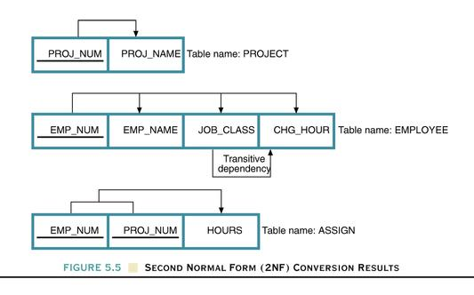
Dependency Diagram

Slide 15
Second Normal Form (2 NF)
A table is in 2NF if:
It is in 1NF and
It includes no partial dependencies; that is, no attribute is dependent on only a portion of the primary key.
(It is still possible for a table in 2NF to exhibit transitive dependency; that is, one or more attributes may be functionally dependent on nonkey attributes.)

Slide 16
Third Normal Form (3 NF)
Conversion to Third Normal Form
Create a separate table with attributes in a transitive functional dependence relationship.
PROJECT (PROJ_NUM, PROJ_NAME)
ASSIGN (PROJ_NUM, EMP_NUM, HOURS)
EMPLOYEE (EMP_NUM, EMP_NAME, JOB_CLASS)
JOB (JOB_CLASS, CHG_HOUR)

Slide 17
Third Normal Form (3 NF)
3NF Definition
A table is in 3NF if:
It is in 2NF and
It contains no transitive dependencies.

Slide 18
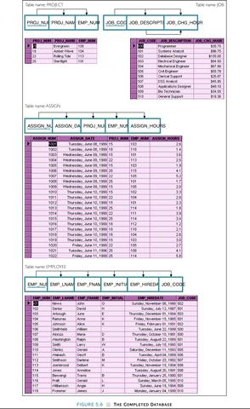
The Completed Database

Slide 19
Boyce-Codd Normal Form (BCNF)
When a relation has more than one candidate key, anomalies may result even though the relation is in 3NF.
3NF does not deal satisfactorily with the case of a relation with overlapping candidate keys
i.e. composite candidate keys with at least one attribute in common.
BCNF is based on the concept of a determinant.
A determinant is any attribute (simple or composite) on which some other attribute is fully functionally dependent.
A relation is in BCNF is, and only if, every determinant is a candidate key.

Slide 20
Boyce-Codd Normal Form (BCNF)
A table is in Boyce-Codd normal form (BCNF) if every determinant in the table is a candidate key.
(A determinant is any attribute whose value determines other values with a row.)
If a table contains only one candidate key, the 3NF and the BCNF are equivalent.
BCNF is a special case of 3NF.
Figure 5.7 illustrates a table that is in 3NF but not in BCNF.
Figure 5.8 shows how the table can be decomposed to conform to the BCNF form.

Slide 21
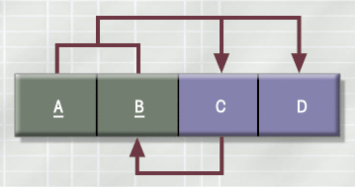
A Table in 3NF but not in BCNF

Slide 22
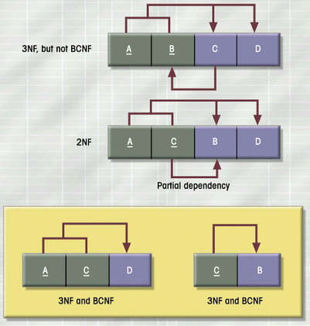
The Decomposition of a Table Structure to Meet BCNF Requirements

Slide 23
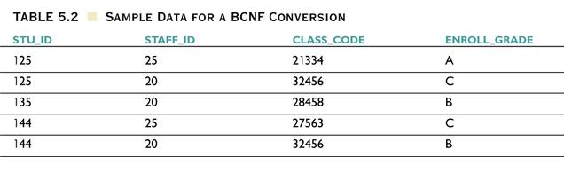
Sample Data for a BCNF Conversion

Slide 24
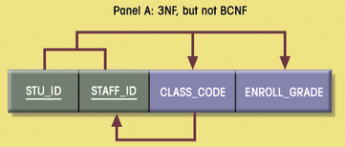
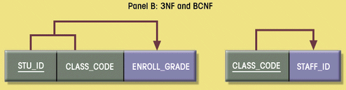
Decomposition into BCNF

Slide 25
Denormalization
Normalization is only one of many database design goals.
Normalized (decomposed) tables require additional processing, reducing system speed.
Normalization purity is often difficult to sustain in the modern database environment. The conflict between design efficiency, information requirements, and processing speed are often resolved through compromises that include denormalization.

Slide 26
Useful Commands/1
Move data into a table
INSERT INTO staff( firstName, lastName, address, homePhone, cellPhone, latitude, longitude ) SELECT firstName, lastName, address, homePhone, cellPhone, latitude, longitude FROM gfxContact

Slide 27
Useful Commands /2 – Create a table from another table
SQL> CREATE TABLE EMP (EMPNO NUMBER(4) NOT NULL, ENAME VARCHAR2(10), JOB VARCHAR2(9), MGR NUMBER(4), HIREDATE DATE, SAL NUMBER(7, 2), COMM NUMBER(7, 2), DEPTNO NUMBER(2));
SQL> SQL> INSERT INTO EMP VALUES (7369, 'SMITH', 'CLERK', 7902, TO_DATE('17-DEC-1980', 'DD-MON-YYYY'), 800, NULL, 20); SQL> INSERT INTO EMP VALUES (7499, 'ALLEN', 'SALESMAN', 7698, TO_DATE('20-FEB-1981', 'DD-MON-YYYY'), 1600, 300, 30); SQL> -- Copying selected columns from another table SQL> CREATE TABLE newTable AS (SELECT empno, ename FROM emp);

Slide 28
Exercise /1
{Cust-No + Name + Addr + Interest-Code + Interest-Desc +{Rec-Id + Title + Performer + Price + Date-Ordered}}
Assume the following:
Rec-Id and Interest-Code are unique.
If you know the Interest-Code you can determine Interest-Desc.
If you know the Rec-Id you can determine Title, Performer.
All customers pay the same price if ordered on the same day.
Prices vary from day to day.
A customer may order the same record more than once but not on the same day.

Slide 29
Execise /2
{Patient-Id + Name + Addr + {Rx# + Trademark-Drug + Generic-Drug + Date}}
Assume the following:
Rx# are unique - never a duplicate for any reason.
Trademark-Drug is unique.
A refill of a Rx has a new Rx#.
If you know Trademark-Drug you can determine Generic-Drug.

Slide 30
Exercise /3
{Order-No + Cust-No + Name + {Prod-No + Prod-Name + Price + Qty}}
Assume the following:
Prod-No and Cust-No are unique.
Prices are the same for all customers.
If you know the Prod-No, you can determine the Prod-Name.
If you know the Cust-No, you can determine the Name.

